Slide 1
Heart Disease Prediction
Relationship between Cholesterols and Age in Heart Disease Patients

Slide 2
Background
How is Cholesterol linked to Heart Disease?
Cholesterol in the blood builds up in the walls of your arteries, causing a process called atherosclerosis, a form of heart disease. The arteries become narrowed and blood flow to the heart muscle is slowed down or blocked. The blood carries oxygen to the heart, and if there is insufficient blood and oxygen reaching your heart, you may suffer chest pain (angina). If the blood supply to a portion of the heart is completely cut off by a blockage, the result is a heart attack.
Extracted from: https://www.webmd.com/heart-disease/guide/heart-disease-lower-cholesterol-risk
Cholesterol levels tend to increase with age. Doctors recommend taking steps earlier in life to prevent dangerously high levels of cholesterol developing as a person ages. Years of unmanaged cholesterol can be much trickier to treat.
Total cholesterol levels less than 200 milligrams per deciliter (mg/dL) are considered desirable for adults. A reading between 200 and 239 mg/dL is considered borderline high and a reading of 240 mg/dL and above is considered high.
Extracted from: https://www.medicalnewstoday.com/articles/315900#recommended-levels

Slide 3
Dataset Background
This dataset was created by combining different datasets already available independently but not combined before. In this dataset, 5 heart datasets are combined over 11 common features which makes it the largest heart disease dataset available so far for research purposes.
The five datasets used for its curation are:
Cleveland: 303 observations
Hungarian: 294 observations
Switzerland: 123 observations
Long Beach VA: 200 observations
Stalog (Heart) Data Set: 270 observations
Total: 1190 observations
Duplicated: 272 observations
Final dataset: 918 observations
Source: https://www.kaggle.com/fedesoriano/heart-failure-prediction

Slide 4
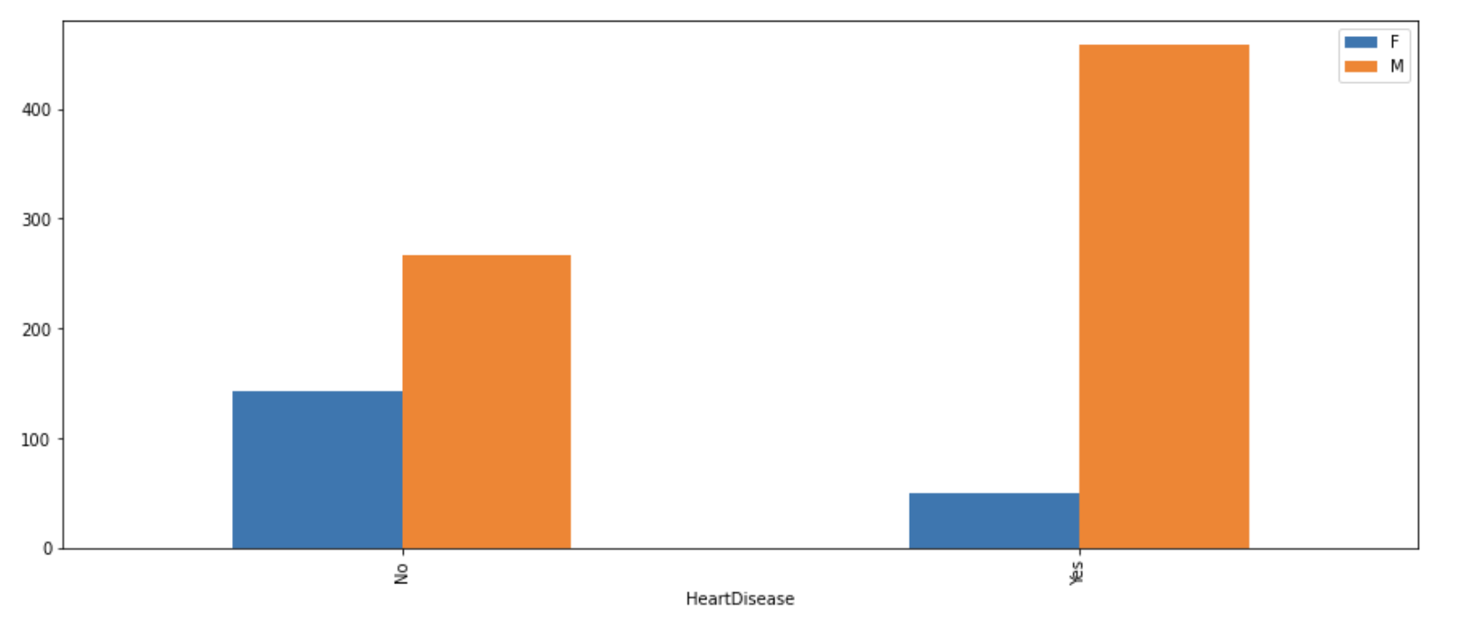
Relationship between Gender & Heart Disease
Male tend to have higher chance of getting Heart Disease than Female

Slide 5
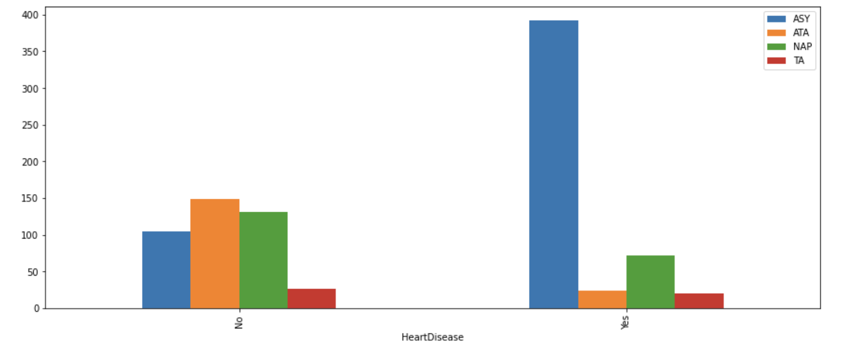
Relationship between Types of Chest Pain & Heart Disease
ASY: Asymptomatic
ATA: Atypical Angina
NAP: Non-Anginal Pain
TA: Typical Angina
More than 50% of the Heart Disease Patient have Asymptomatic Chest Pain

Slide 6
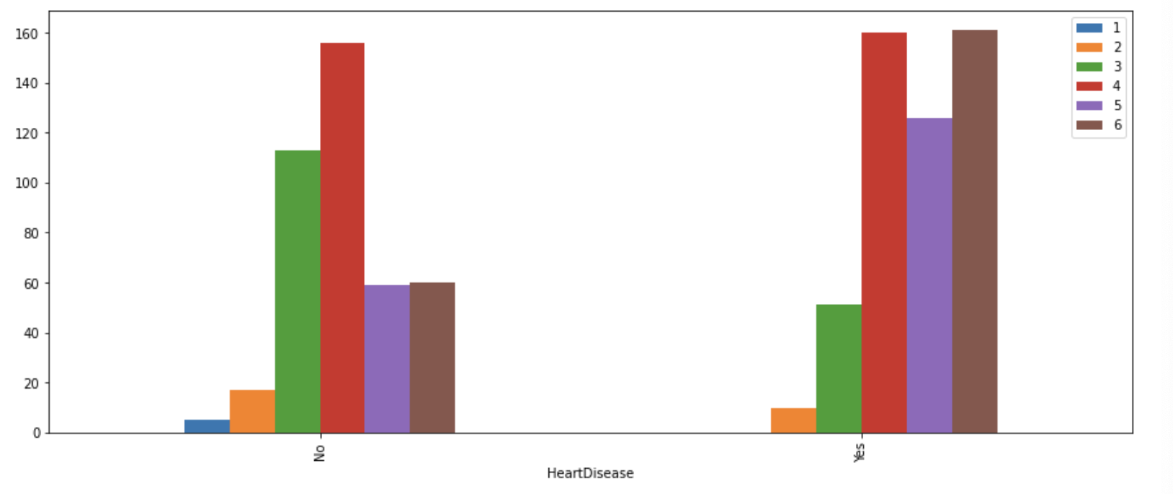
Relationship between Age & Heart Disease
1: Age 30 and below
2: Between age 31 -35
3: Between age 36 - 45
4: Between age 46 -55
5: Between age 56-60
6: Age 61 and above
Above age 45 will have about 50% chances of getting heart disease and the probability will increase as age increases above 46
Below age 30 will have lower chances of getting heart disease.

Slide 7
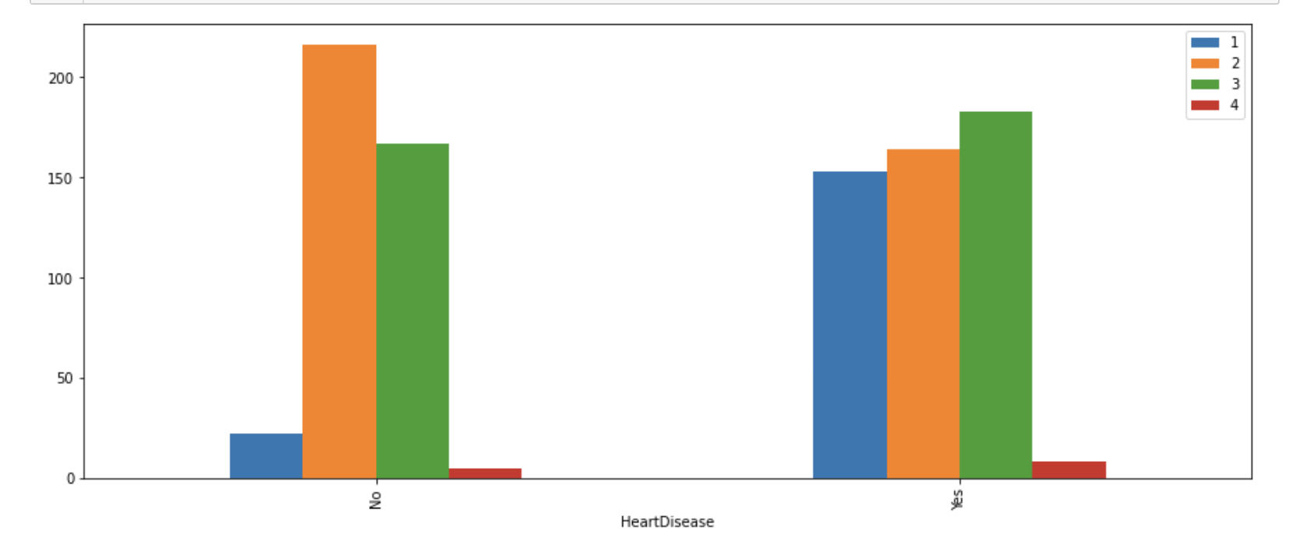
Relationship between Cholesterol Level & Heart Disease
1: 100 and below
2: Between 100-239
3: Between 240-400
4: Above 401
Level indicated are in (mm/dl)
More than 50% of the Heart Disease Patient have cholesterol level at 240mm/dl or higher.

Slide 8
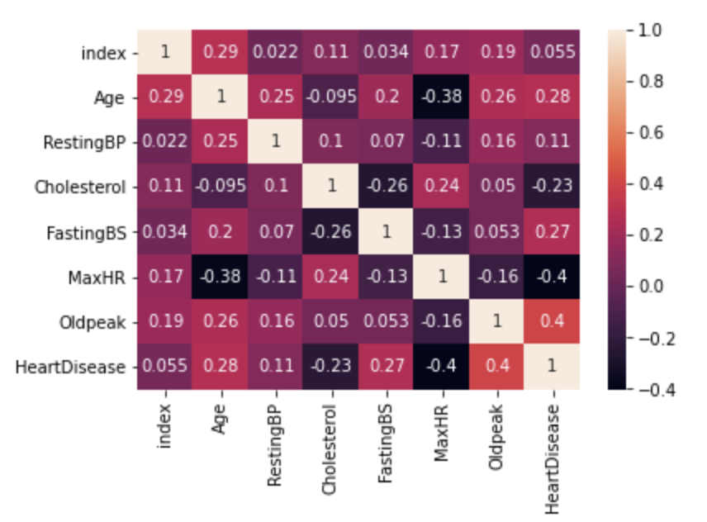
Heatmap- Correlation

Slide 9
Hypothesis
'H0': 'Older age groups will have similar level of cholesterol as young age groups. (LH - SH = 0)',
'H1': 'Older age groups will have higher level of cholesterol than young age. (LH - SH > 0)'
Random Sample Size = 100
Older age groups = Age above 45
Young age group = Age 45 and below
Conclusion: Fail to reject the H0 when the null hypothesis is false
Older age groups will have higher level of cholesterol as young age groups

Slide 10
Findings
Conclusion based on hypothesis: Older age groups will have higher level of cholesterol as young age groups
Data size is not large enough to determine the relationship of age and cholesterol (>1000 rows)
Not enough sample size to analyze the hypothesis better (less than 100 samples for less than age 45 has heart disease ==1)
Gender may also play a part in possibility of having heart disease: Male have higher chances of heart disease (based on bar chart). Further analysis have to be done to verify the relationship between gender and cholesterol level
Cholesterol can be categorized into 2 different kinds (which is not differentiated in the dataset):
LDL (low-density lipoprotein), sometimes called “bad” cholesterol, makes up most of your body’s cholesterol. High levels of LDL cholesterol raise your risk for heart disease and stroke.*
HDL (high-density lipoprotein), or “good” cholesterol, absorbs cholesterol and carries it back to the liver. The liver then flushes it from the body. High levels of HDL cholesterol can lower your risk for heart disease and stroke.*
Heart Disease can be caused by other factors such as unhealthy diet, physical inactivity, tobacco use and harmful use of alcohol** (which is not covered in the data set).
*Source: https://www.cdc.gov/cholesterol/ldl_hdl.htm
**Source: https://www.who.int/news-room/fact-sheets/detail/cardiovascular-diseases-(cvds)

Slide 11
Thank You

